Slide 1

Optimization of CNN Models for Exchange Rate Prediction Using PSO
Exploring advanced PSO optimization to enhance CNN forecasts of currency exchange rates. presented by : farouk mohamed

Slide 2

Introduction
Forecasting Importance
Traditional CNN Limits
Optimization Motivation
Critical for global finance and risk management
Suboptimal hyperparameters reduce accuracy
Use PSO to automate parameter tuning

Slide 3

Project Objectives
CNN Model
PSO Optimization
Develop for univariate time series prediction
Enhance accuracy via hyperparameter tuning
Performance Comparison
Analyze pre- and post-optimization results

Slide 4
Methodology Overview
Dataset & Preprocessing
CNN Architecture
PSO Optimization
Historical GBP/USD exchange data
1D convolution for temporal patterns
Swarm-based hyperparameter search
Normalization and cleaning steps
Pooling and dense layers
Dynamic convergence criteria

Slide 5
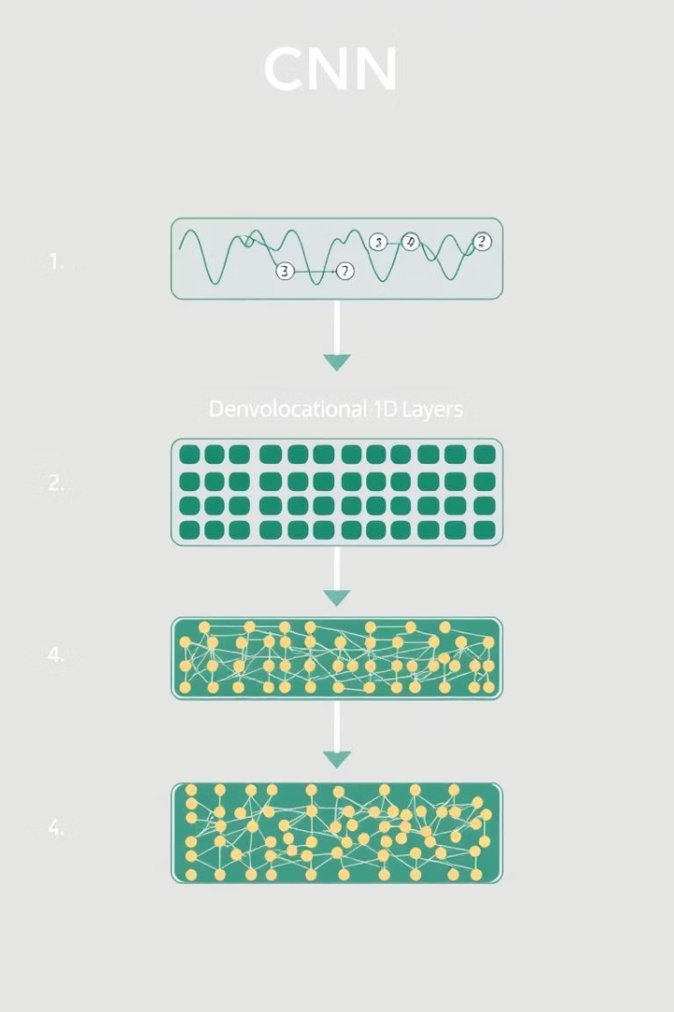
Model Architecture
Layer Sequence
Conv1D → MaxPooling1D → Flatten → Dense
Hyperparameters Tuned
Kernel size=, filters, neurons, learning rate
num_conv_layers: 1
filters_layer_1: 16
filters_layer_2: 177
filters_layer_3: 396
kernel_size_layer_1: 4
kernel_size_layer_2: 2
kernel_size_layer_3: 2
num_dense_layers: 1
dense_neurons_layer_1: 201

Slide 6
Original CNN Model – Results
Test RMSE: 0.03028
Model underfits rapid fluctuations
Test Accuracy: 0.02574

Slide 7

PSO-Optimized CNN – Results
RMSE: 0.00654
Prediction tracks actual exchange rate trends accurately

Slide 8
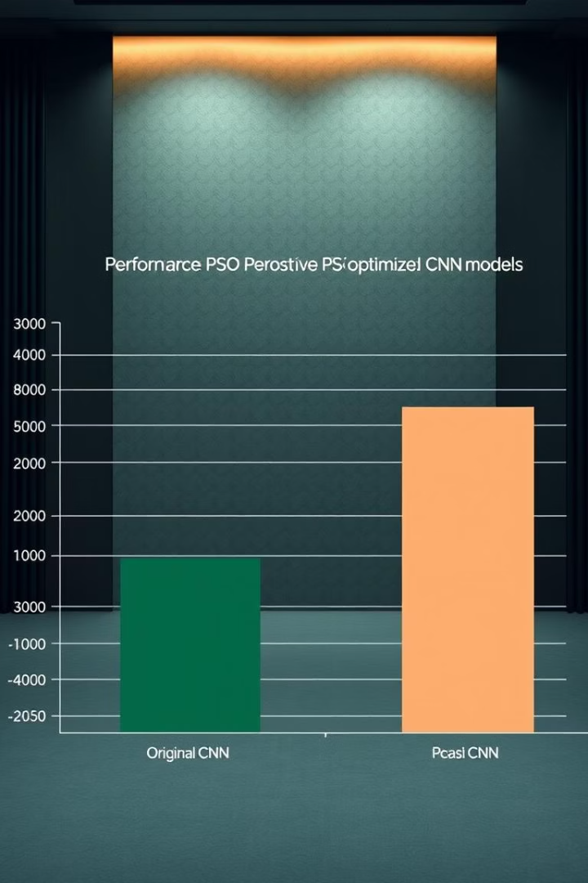
Performance Comparison
Original CNN RMSE
0.03028
PSO-CNN RMSE
0.00654
Improvement
78.40% reduction

Slide 9

Conclusion
Performance Boost
Prediction Reliability
Methodological Value
PSO drastically improves forecast accuracy
More consistent and precise exchange rate forecasts
Validates integration of CNN with evolutionary optimization

Slide 10




Future Work
Multivariate Inputs
Extend models to incorporate multiple currency pairs
Alternative Algorithms
Explore Genetic Algorithm and Bayesian Optimization
Real-time Deployment
Implement live forecasting systems

